Slide 2






Model for Managing Complex Change (Lippitt-Knoster)
Vision | Skills | Incentives | Resources | Action Plan
Vision | Skills | Incentives | Resources | Action Plan
Vision | Skills | Incentives | Resources | Action Plan
Vision | Skills | Incentives | Resources | Action Plan
Vision | Skills | Incentives | Resources | Action Plan
Vision | Skills | Incentives | Resources | Action Plan
Success
Confusion
Anxiety
Restistence
Frustration
Treadmill

Slide 3
Vision | Skills | Incentives | Resources | Action Plan
Vision | Skills | Incentives | Resources | Action Plan
Vision | Skills | Incentives | Resources | Action Plan
Vision | Skills | Incentives | Resources | Action Plan
Vision | Skills | Incentives | Resources | Action Plan
Vision | Skills | Incentives | Resources | Action Plan
Is there a shared understanding in the community about the purpose and benefits?

Slide 4
Vision | Skills | Incentives | Resources | Action Plan
Vision | Skills | Incentives | Resources | Action Plan
Vision | Skills | Incentives | Resources | Action Plan
Vision | Skills | Incentives | Resources | Action Plan
Vision | Skills | Incentives | Resources | Action Plan
Vision | Skills | Incentives | Resources | Action Plan
Do reserachers currently have the necessary skills and knowledge?

Slide 5
Vision | Skills | Incentives | Resources | Action Plan
Vision | Skills | Incentives | Resources | Action Plan
Vision | Skills | Incentives | Resources | Action Plan
Vision | Skills | Incentives | Resources | Action Plan
Vision | Skills | Incentives | Resources | Action Plan
Vision | Skills | Incentives | Resources | Action Plan
Are there sufficient incentives for researchers?

Slide 6
Vision | Skills | Incentives | Resources | Action Plan
Vision | Skills | Incentives | Resources | Action Plan
Vision | Skills | Incentives | Resources | Action Plan
Vision | Skills | Incentives | Resources | Action Plan
Vision | Skills | Incentives | Resources | Action Plan
Vision | Skills | Incentives | Resources | Action Plan
Are the necessary resources available and accessible to researschers?

Slide 7
Vision | Skills | Incentives | Resources | Action Plan
Vision | Skills | Incentives | Resources | Action Plan
Vision | Skills | Incentives | Resources | Action Plan
Vision | Skills | Incentives | Resources | Action Plan
Vision | Skills | Incentives | Resources | Action Plan
Vision | Skills | Incentives | Resources | Action Plan
Are there clear steps currently in place to promote it in our field?

Slide 8



Let‘s apply this perspective to…
Preregistration & Registered Reports
B: t1p.de/sig-prereg
Open and Reproducible Code
Open and Fair Data
A: t1p.de/sig-data
C: t1p.de/sig-code

Slide 9







Guiding questions
1
Current status
2
Greatest need
3
Specific actions
Vision
Skills
Incentives
Resources
Action Plan
Vision
Skills
Incentives
Resources
Action Plan
Use dropdown menu in google docs
A: t1p.de/sig-data
B: t1p.de/sig-prereg
C: t1p.de/sig-code

Slide 10

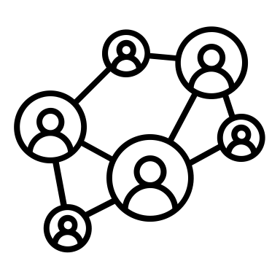

Plenary discussion

